Slide 1
Employee Management System
In C Language
Presented By
Aditya Khurana
Employee ID : 201271
AES ENSEMBLE

Slide 2
AGENDA
Defining the Structure
The Starting Point
Accept Employee
The Main Logic
Output

Slide 3
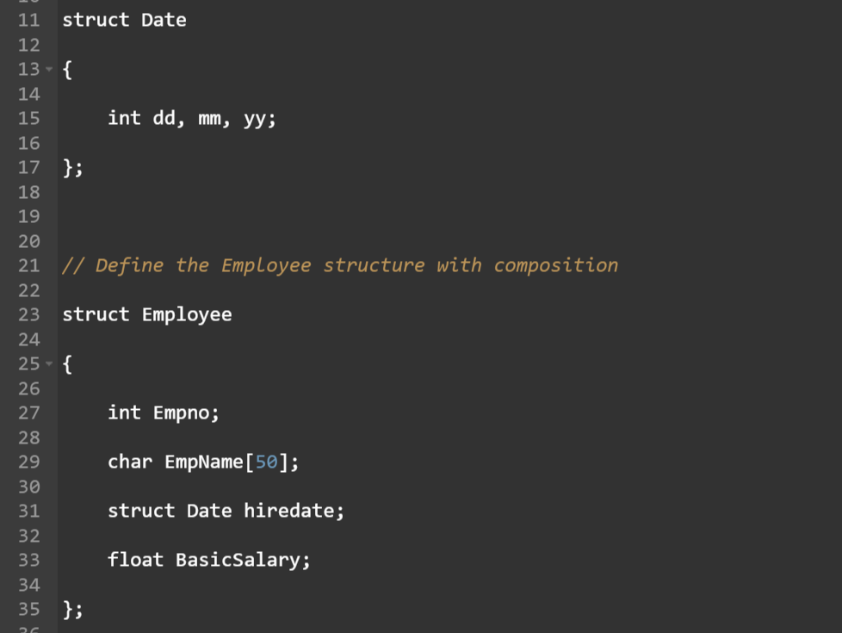
Defining the Structure

Slide 4
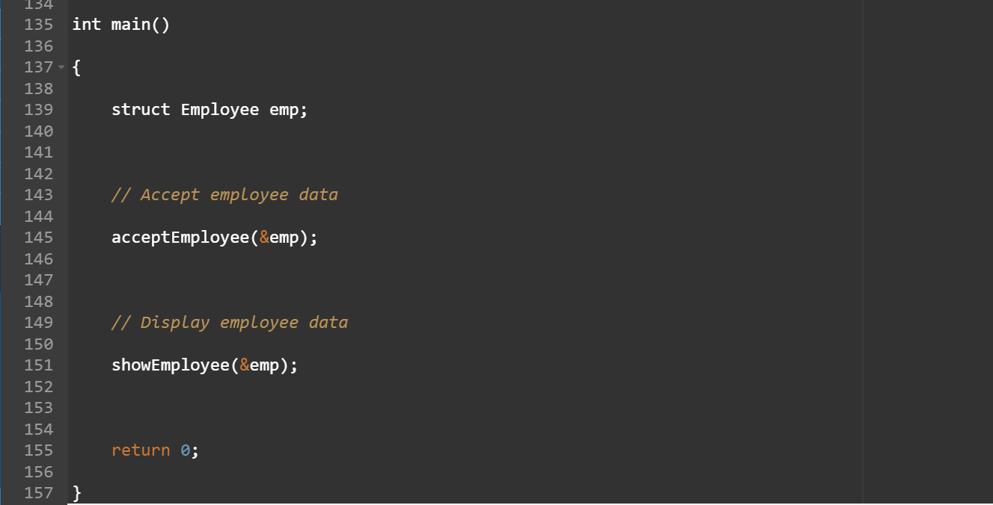
The Starting Point

Slide 5
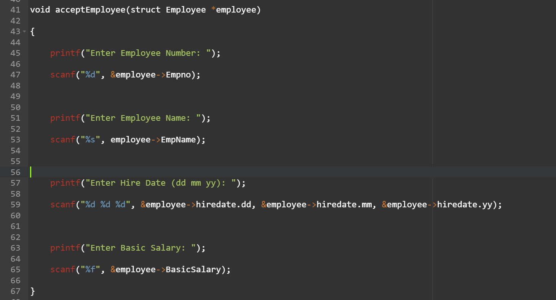
Accept Employee

Slide 6
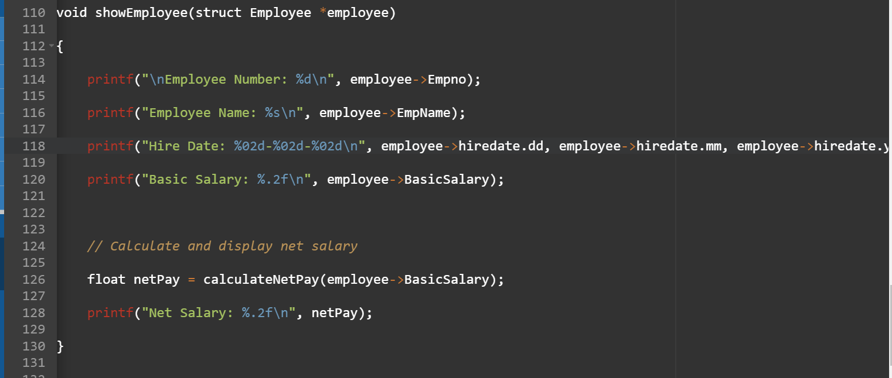
Show Employee

Slide 7
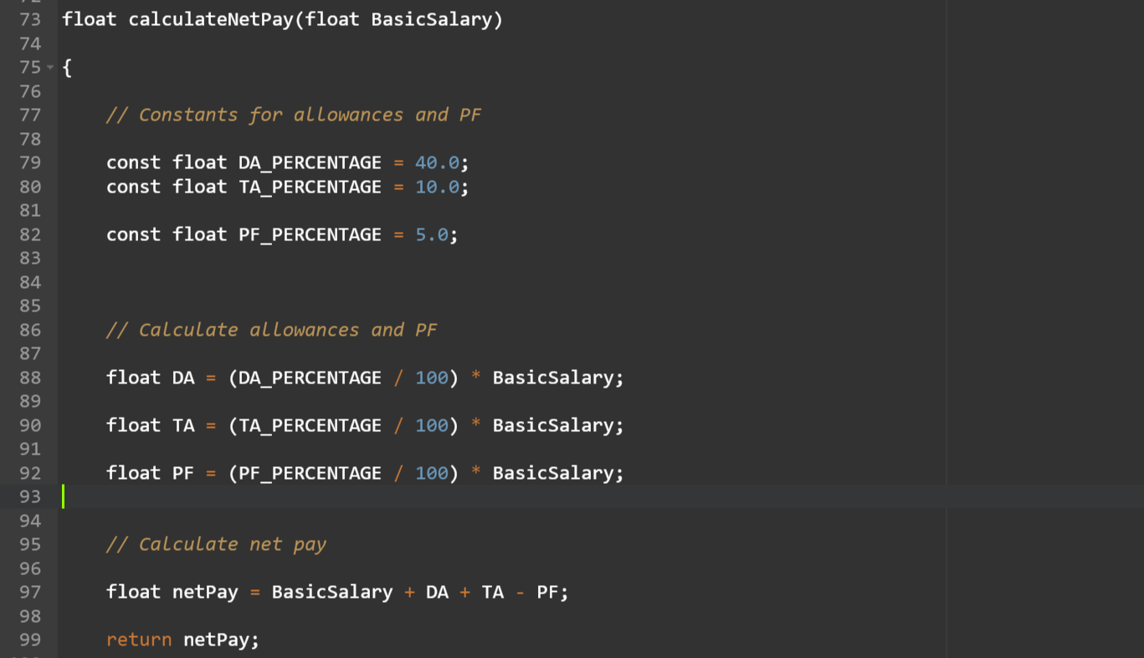
The Main Logic

Slide 8
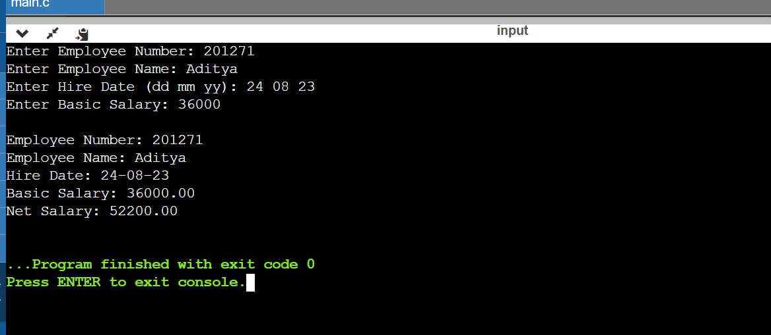
Output

Slide 9
Thank You!

